Slide 1

Module 2: Firewall Design and Implementation
Prepared By:
Prof. Sridhar C Iyer
Assistant Professor
Dept. of Computer Engineering
Dwarkadas J Sanghvi College of Engineering

Slide 2

Introduction
A firewall is a vague concept, but is usually characterized as a barrier or a filter between internal and external network traffic.
The name originates from the special device installed in buildings to separate parts that need to be protected from the rooms with open fire places.
In order to keep the data safe and secure, many organizations employ firewalls to separate their networks and hosts from outside segments. When a computer from an internal network makes a connection to the untrusted outside part, packets that might include malicious contents could get transmitted between them.

Slide 3
Introduction
Once a malicious packet gets an access to the resources of the inside computer, then the whole internal network could get compromised.
A good firewall will have the ability to detect the harmful packets and also drop them depending upon the situation.
Firewalls' work is controlled by the rules or instructions given to them. Good design of the rules assures improved system operation and results in a safer and more secure system.
The way how to design the rules depends a lot on the type of traffic that needs to be analyzed and filtered. Organizations may adopt different firewalls and thus different rulesets based on the network traffic variant. The best practice of choosing good rulesets is proactive instead of reactive.
It involves taking into consideration the physical environment of the system, the configuration and future possible modifications that will be made to the system, so that even if the system changes in the future, the design of the rulesets will remain manageable.

Slide 4
Introduction
Whether it is implemented in hardware, firmware, or anywhere on the IP stack, all firewalls follow the same basic design principle.
Its main function is to filter traffic according to its policy, where a firewall policy is composed as a set of rules that determine whether a piece of traffic is considered valid, and allowed through the firewall, or if it is considered potentially harmful, and has to be blocked by the firewall.
In practice, a firewall acts as a layer that helps protect one network or host/domain from attacks initiated in another network or host/domain.
In computer networks, the firewalls have taken over routers that separated local areas from external networks.

Slide 5
Introduction
A firewall, protecting the local network perimeter, is considered as an organization's network first line of defense. It is designed to comply with the three major aspects of computer security: confidentiality, integrity, and availability.
It preserves confidentiality by protecting information that might be important. It attempts to prevent unauthorized access to information to enforce confidentiality as well as integrity.
It regulates data availability by filtering the traffic. The firewall can be adjusted to allow for information availability for authorized users. As a result, it is more than just one piece of hardware or software, it is more like a conceptual design that performs specific functions.
The main function of a firewall is to determine whether a traffic segment should be allowed or blocked. A firewall can be seen as a security point where content coming in or out is checked before being allowed to pass through.

Slide 6
Introduction
Firewalls can be implemented on just one computer or a router, or even on a group of systems (Vacca and Ellis 2005). As a result, firewalls can be either software or hardware based.
Each kind has its own pros and cons. Hardware firewalls, also known as firewall appliances, can be really costly. The price tag grows up even more expensive when they need to be upgraded (Michael Stewart 2014). However, they provide a much higher speed than software firewalls, mainly because they have dedicated processors for filtering purposes.
This is especially important in enterprise settings and for multimedia applications (Fulp 2017). Additionally, some hardware firewalls possess a wider range of features than the software firewalls (Michael Stewart 2014).

Slide 7
Hardware vs Software Firewalls
Many routers contain a firewall implemented in hardware, which can do basic packet filtering. A hardware firewall can inspect source and destination addresses in a packet header, and act on predefined or user-defined rules based on those alone.
While this filtering method is vulnerable to IP spoofing, a hardware firewall is still useful.
One example of a hardware firewall would be an outgoing traffic filter, which checks up that all outcoming traffic has the source IP valid within a user-defined IP range.
Such a firewall could block all egress (outcoming) traffic that contained a spoofed source IP address.

Slide 8
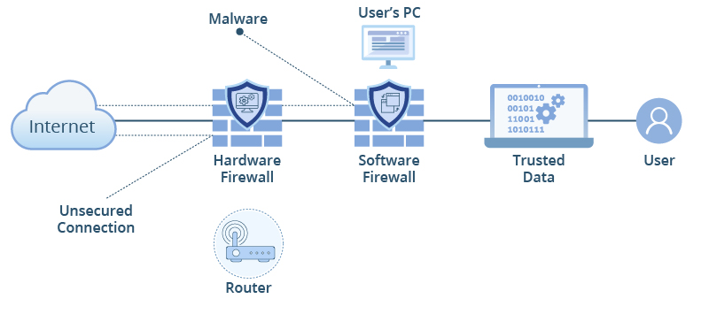
Hardware vs Software Firewalls

Slide 9
Hardware vs Software Firewalls
Software firewalls are generally much cheaper and affordable for an average individual user.
In addition, many operating systems offer software firewalls already incorporated, and they are usually set up by default for convenience of the user.
Software firewalls are also much easier to change with upgrades being typically free or cheap.
A software firewall does not have its own dedicated hardware, having to share resources with other programs and processes that might result in lowering the performance, especially in an emergency situation, for example, when the protected system or network gets under an attack.
Additionally, other OS components can be exploited to bypass or affect the firewall (Fulp 2017). Unfortunately, both types can be vulnerable to flaws in code (Michael Stewart 2014).

Slide 10
Hardware vs Software Firewalls
Firewalls can also be positioned at different places. A common place to put a firewall is either on the host directly or around a network. Network firewalls tend to be standalone devices.
They can be both software and hardware based, although in many enterprise situations, they are hardware implemented (Fulp 2017).
Host-based firewalls tend to be software firewalls and are situated on the host as a program on the computer.
Since a host-based firewall and a network firewall are located at different places, both types can be installed for added security, and in fact, this dualism is encouraged.

Slide 11
Hardware vs Software Firewalls
Host-based firewalls have several advantages. These firewalls can be tailored specifically for the particular host.
For example, a lab computer can be restricted to allowing only certain applications that a student might need, while an administrator's choice of programs may be more open.
Also, if a new system is added to the network, the system can have its own customized firewall with additional restrictions without changing the network firewall. Host-based firewalls are also often simplified for a user, so average users can easily take basic steps to further protect themselves (Stallings 2014).

Slide 12
How does a Firewall Work?
A firewall generally has four ways it can control the traffic passing through it.
The first way is by controlling the services performed. It can prevent or allow certain types of services to be accessed or run (Stallings 2014).
The second way is by controlling the direction of the connection. It can block, accept, or restrict traffic going either in both directions, or only either in or out of the protected area. Filtering an inbound traffic is referred to as an ingress filtering, while filtering an out- bound traffic is known as an egress filtering (Michael Stewart 2014).
The firewall can also control access based on who is sending traffic in or out as well.
Lastly, the firewall can also control how services are used, which is helpful in cases, in which a legitimate service is being used to compromise the system (Stallings 2014).

Slide 13
History of Firewalls
The first firewall that was reportedly employed and proved its functionality in a real-world context was managed by William Cheswick. In 1988, a worm called the 1988 Morris Internet worm infected hundreds of computers across various networks.
However, due to the firewall's settings and a bit of luck, the firewall protected its local network and the computers inside were unaffected by the worm.
The luck part is referred to the firewall configuration that made it able to defend the system against this worm.
This story demonstrated a firewall effectiveness, but conditional to being properly configured.
The value of firewalls was proven once again when Windows XP became the first OS release that included a firewall as it resulted in a large drop in successful attacks involving Windows target malware.

Slide 14
History of Firewalls
The application demonstrated that even a simple firewall with basic settings could help defend against attacks. It also hinted that many attackers may had used the same common exploits over and over again because they did not possess enough knowledge or time to modify them.
Even a basic firewall is helpful because it could thwart most attacks as long as they follow up the same patterns and the firewall is configured to detect those patterns. In the case of the application proxy firewall, one of the attack types these firewalls could prevent was the remote buffer overflow attack (Grimes 2017).

Slide 15
History of Firewalls
Depending on the size of the network to defend and the value of the material to protect, anything from a commercial off the shelf (COTS) consumer firewall to an in-house-designed network defense may be used.
Typically, COTS solutions suffer from a widespread adoption and known bugs and vulnerabilities but are significantly cheaper than a custom-built solution that many large organizations employ.
Additional coverage beyond a firewall is also required. Many consumer solutions offer "suite" products to provide integrated firewall, antivirus, and logging systems to better protect home and enterprise systems. These together can provide a far stronger defense against intrusions than a firewall (no matter how sophisticated) alone.

Slide 16
History of Firewalls
Before Firewalls, network security was performed by Access Control Lists (ACLs) residing on routers. ACLs are rules that determine whether network access should be granted or denied to specific IP address but ACLs cannot determine the nature of the packet it is blocking.
Also, ACL alone does not have the capacity to keep threats out of the network. Hence, the Firewall was introduced. Connectivity to the Internet is no longer optional for organizations.
However, accessing the Internet provides benefits to the organization; it also enables the outside world to interact with the internal network of the organization. This creates a threat to the organization. In order to secure the internal network from unauthorized traffic, we need a Firewall.

Slide 17
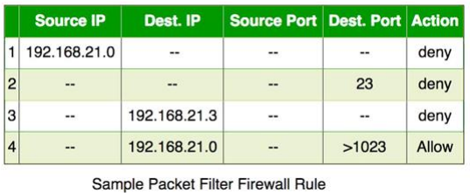
First Generation- Packet Filtering Firewall
Packet filtering firewall is used to control network access by monitoring outgoing and incoming packet and allowing them to pass or stop based on source and destination IP address, protocols and ports. It analyses traffic at the transport protocol layer (but mainly uses first 3 layers).
Packet firewalls treat each packet in isolation. They have no ability to tell whether a packet is part of an existing stream of traffic. Only It can allow or deny the packets based on unique packet headers. Packet filtering firewall maintains a filtering table which decides whether the packet will be forwarded or discarded. From the given filtering table, the packets will be Filtered according to following rules:

Slide 18
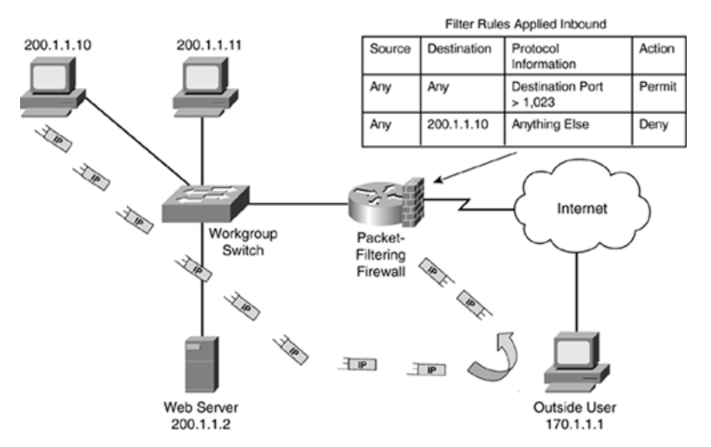
First Generation- Packet Filtering Firewall
Incoming packets from network 192.168.21.0 are blocked. Incoming packets destined for internal TELNET server (port 23) are blocked. Incoming packets destined for host 192.168.21.3 are blocked.
All well-known services to the network 192.168.21.0 are allowed.
It is the simplest and easy to implement firewall.
If this firewall is placed just behind the router, then the traffic can be analyzed easily.
The biggest disadvantage of the packet filtering firewalls is that it requires a lot of detailing to set policies

Slide 19
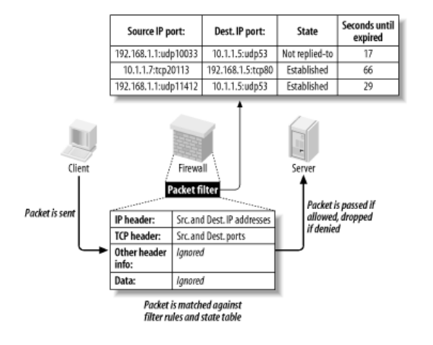
Second Generation - Stateful Inspection Firewall:
Packet Filtering is done 1 packet at a time. Sometimes the attackers may use this technique for their attacks. Attackers can split their complete script of attack into different packets so that the complete script of attack cannot be identified by the packet filtering firewall.
To avoid this, stateful inspection firewalls were introduced which keeps record of the states of the packets from one to another.
Stateful firewalls (performs Stateful Packet Inspection) are able to determine the connection state of packet, unlike Packet filtering firewall, which makes it more efficient.
It keeps track of the state of networks connection travelling across it, such as TCP streams. So, the filtering decisions would not only be based on defined rules, but also on packet’s history in the state table

Slide 20
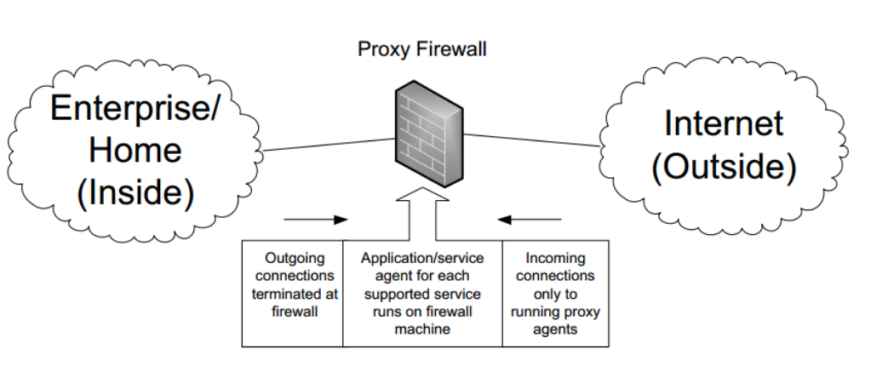
Third Generation - Application Layer Firewall (Proxy Firewalls):
Packet filters cannot see the content of each packet. From the packet headers, they just get the IP addresses for filtering.
Application layer firewall can inspect and filter the packets on any OSI layer, up to the application layer. It has the ability to block specific content, also recognize when certain application and protocols (like HTTP, FTP) are being misused.
In other words, Application layer firewalls are hosts that run proxy servers. A proxy firewall prevents the direct connection between either side of the firewall, each packet has to pass through the proxy. It can allow or block the traffic based on predefined rules

Slide 21
Next Generation Firewall
Next Generation Firewalls are being deployed these days to stop modern security breaches like advance malware attacks and application-layer attacks. NGFW consists of Deep Packet Inspection, Application Inspection, SSL/SSH inspection and many functionalities to protect the network from these modern threats.
Some common features of next-generation firewall architectures include deep-packet inspection (checking the actual contents of the data packet), TCP handshake checks, and surface-level packet inspection.
Next Generation firewalls may include other technologies as well, such as intrusion prevention systems (IPSs) that work to automatically stop attacks against your network.

Slide 22
Personal Firewalls
A personal firewall is software application that shields internet users from potential hackers by permitting or denying network traffic to and from their computer and warning them about attempted intrusions.
It’s like a filter between the Internet and your network.
A personal firewall differs from a conventional firewall in terms of scale.
A personal firewall will usually protect only the computer on which it is installed, as compared to a conventional firewall which is normally installed on a designated interface between two or more networks, such as a router or proxy server.
Hence, personal firewalls allow a security policy to be defined for individual computers, whereas a conventional firewall controls the policy between the networks that it connects.
Common personal firewall features:
Block or alert the user about all unauthorized inbound or outbound connection attempts.
Allows the user to control which programs can and cannot access the local network and/or Internet and provide the user with information about an application that makes a connection attempt.
Hide the computer from port scans by not responding to unsolicited network traffic.
Monitor applications that are listening for incoming connections.
Monitor and regulate all incoming and outgoing Internet users.
Prevent unwanted network traffic from locally installed applications.
Provide information about the destination server with which an application is attempting to communicate.
Track recent incoming events, outgoing events, and intrusion events to see who has accessed or tried to access your computer.
Blocks and prevents hacking attempt or attack from hackers.

Slide 23
Classification of Firewalls
Choosing the wrong firewall configuration can actually damage network security. That's why it's important to be aware of the available options before making a decision.
Firewalls come in various forms, and companies must find a solution that meets their unique networking needs. Broadly speaking, there are two ways of understanding the types of firewalls.
Delivery. This refers to where firewalls operate in the network context. Delivery options can include hardware, software, or cloud-based systems.
Method of Operation: This refers to how firewalls actually work. Firewall technology includes packet inspection, proxy or app-based firewalls, Stateful firewalls, and next generation systems

Slide 24
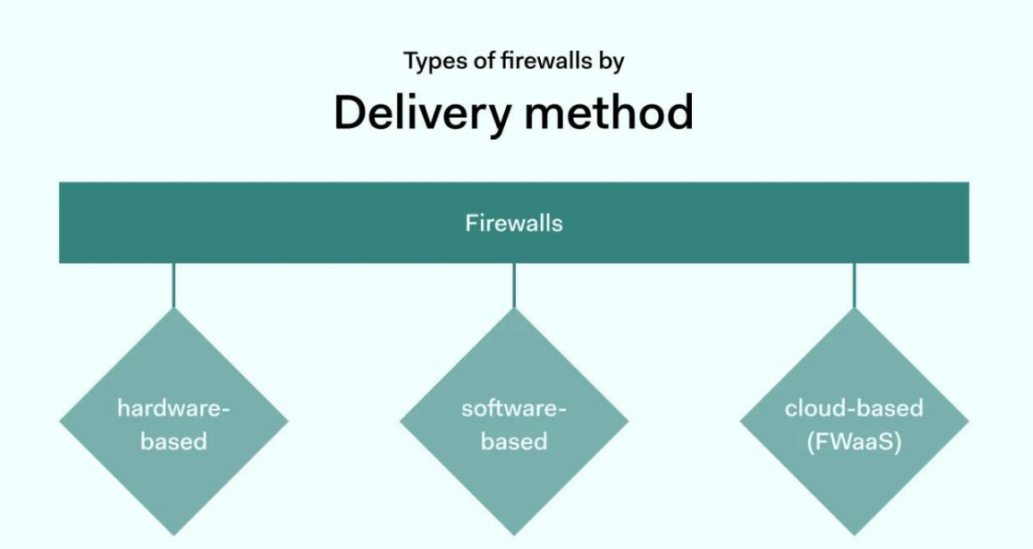
Firewalls Based on Delivery Method

Slide 25
Firewalls Based on Delivery Method
Hardware-based firewalls:
Hardware firewalls are installed on specialist devices within your network rack.
These devices contain firmware that creates a barrier between the external internet and on premises systems.
Inbound traffic must traverse this barrier, which provides a secure boundary to block malicious attacks. Hardware-based firewalls inspect traffic entering and leaving the network, using IP address data to block blacklisted addresses and block unauthorized traffic.
Solutions can also be more complex. For instance, hardware-based firewalls may block unused ports and prevent traffic using them. This counteracts a common route for data exfiltration. Hardware varies in size, from desktop units to designs for server rooms.
Stateful models also add extra functionality, enabling deep dives into the content of data packets

Slide 26
Firewalls Based on Delivery Method
Hardware-based firewalls:
Advantages of hardware firewalls:
Users can configure hardware to meet specific network conditions.
Firewalls provide protection without using resources on workstations or servers.
Updates apply to single devices, making management easier.
Hardware is less vulnerable to OS exploits, so may be more secure.
Security teams can centralize data monitoring via a single firewall device.

Slide 27
Firewalls Based on Delivery Method
Hardware-based firewalls:
Disadvantages of hardware firewalls:
Sourcing hardware is expensive compared with software-based alternatives.
Devices can be bulky, adding clutter to office environments. Additional hardware is always required.
Upgrades can be challenging. Security teams may need to patch firmware and/or replace equipment.
Scaling up hardware systems is cumbersome. Companies may be reluctant to update firewalls after investments in expanding their hardware. This may lock in security vulnerabilities over time.
Hardware-based firewalls are becoming less popular. However, they may still be useful in situations where companies need total control over specific security situations. Otherwise, lightweight software or cloud solutions make more sense.

Slide 28
Firewalls Based on Delivery Method
2. Software-based firewalls:
Software firewalls provide the same services as hardware-based firewalls but require no separate equipment. Instead, software firewalls run on network devices.
For example, Microsoft Windows and macOS come with a native firewall to protect internet traffic.
Users can install software-based firewalls on individual workstations but they can also install them on servers to provide network-wide protection.

Slide 29
Firewalls Based on Delivery Method
2. Software-based firewalls:
Advantages of software firewalls:
Users can apply granular security protection for each device.
Capable of filtering content arriving at individual devices, not just at the network edge.
Firewalls are easy to install. There is no need for specialist technical networking knowledge.
They often come bundled with operating systems and servers.
Affordable to set up and run. Extend easily across on-premises environments.

Slide 30
Firewalls Based on Delivery Method
2. Software-based firewalls:
Disadvantages of software firewalls:
Software may be incompatible with network devices, creating security gaps or requiring costly adaptations.
While installation is simple, software must be updated on all network devices. This is complex and prone to human error.
Software consumes resources on individual devices. This can impair network performance

Slide 31
Firewalls Based on Delivery Method
3. Cloud-based firewalls (FWaaS):
Software and hardware-based firewalls operate in traditional on-premises environments.
They protect groups of devices against external threats.
Cloud-based firewalls are different. Firewall-as-a-Service exists in the cloud and requires no extra hardware or software installation.
Cloud firewalls primarily protect cloud assets. This includes Software-as-a-Service (SaaS) apps as well as Infrastructure-as-a-Service (IaaS) and Platform-as-a-Service (PaaS) implementations.
At the same time, cloud firewalls extend protection to on-premises servers and remote work devices. Instead of using software or hardware, they employ cloud-based applications to monitor traffic and block attacks.

Slide 32
Firewalls Based on Delivery Method
3. Cloud-based firewalls (FWaaS):
Advantages of software firewalls:
Optimized protection for SaaS applications and cloud infrastructure. Virtual firewalls are located close to cloud resources. This reduces the need to backhaul data and boosts efficiency.
Centralized management: Administrators can configure firewalls from a single device and apply controls to all cloud users.
Integration with IAM and SSO portals. Users can combine firewall protection and cloud authentication systems.
Lightweight, off-the-shelf protection from third-party experts. No installation or hardware is required. This makes cloud firewalls a good option for companies with small tech teams.
Smooth expansion: Cloud firewalls scale easily as SaaS applications come online.
These advantages make cloud-based firewalls attractive for companies reliant on hybrid cloud environments and remote working. But cloud firewalls also have some potential drawbacks.

Slide 33
Firewalls Based on Delivery Method
3. Cloud-based firewalls (FWaaS):
Disadvantages of software firewalls:
Users must rely on third party providers. Reliance on third-parties generally reduces customization options. Providers may fail to deliver promised security functions. Clients may suffer if virtual firewalls experience availability issues.
Subscription payments may result in high costs

Slide 34
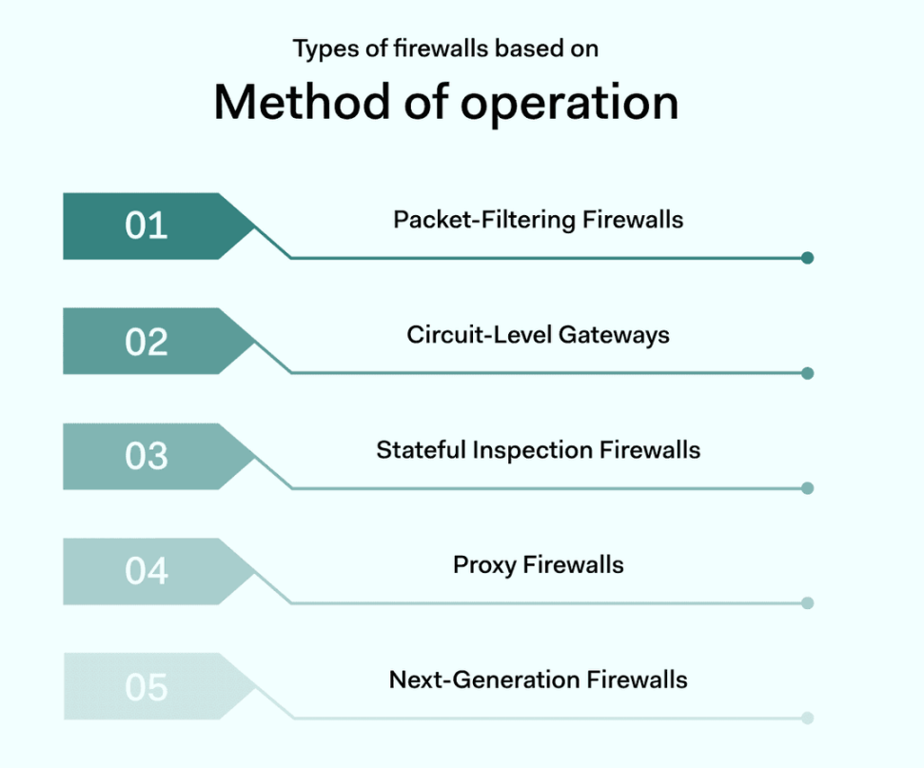
Firewalls Based on Method of operation

Slide 35

A Demo.

Slide 36
Firewalls Based on Method of Operation
Packet Filtering Firewalls:
Packet-filtering firewalls assess data packets passing across network boundaries. Each packet must be compared to a set of pre-defined rules. If the packets meet these rules, the firewall allows traffic to pass. If not, packets are blocked and alerts may be issued.
Information assessed by packet-filtering firewalls can include the destination port in use, the type of packet, and the destination IP address. This data provides a snapshot of where incoming packets come from, who is sending them, and whether they are safe.
Packet filtering firewalls are generally installed at junctions within network environments. They may operate alongside switches and routers, processing traffic at high-volume locations. This enables packet-filtering firewalls to handle traffic for an entire network

Slide 37
Firewalls Based on Method of Operation
Packet Filtering Firewalls:
Advantages of packet-filtering firewalls:
Low data requirements make them relatively fast and efficient.
Can cover the whole network with ease.
Affordable to install and maintain.
Low data overheads, minimal impact on network performance.
Disadvantages of packet filtering firewalls:
PFFs do not catch all security threats and only analyzes limited amounts of information.
Payload spoofing can compromise firewall protection.
Managing access control ledgers can be problematic.

Slide 38
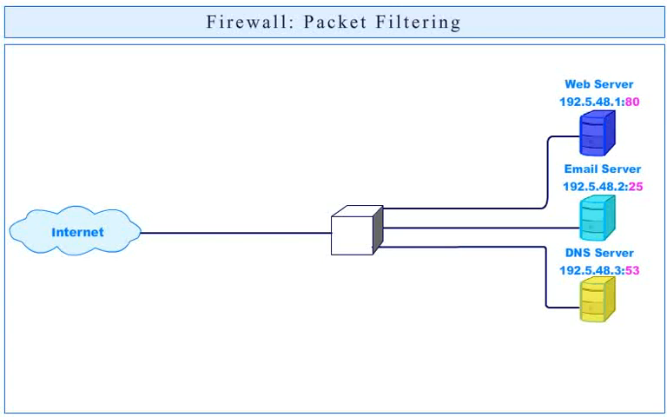
Firewalls Based on Method of Operation
Packet Filtering Firewalls (DEMO)

Slide 39
Firewalls Based on Method of Operation
2. Circuit Level Gateways:
Circuit level gateways operate at the session level. They assess traffic when local and remote hosts establish a connection. If this connection is deemed insecure, circuit level gateways will close and prevent communication between the two devices.
Circuit level gateways use session information such as TCP handshaking and protocol messaging. By leveraging this information, the circuit level gateway can establish whether sessions are legitimate.
There is no data packet inspection. Everything relates to the way connections are created.

Slide 40
Firewalls Based on Method of Operation
Circuit Level Gateways:
Advantages of circuit level gateways:
They are affordable to implement and have little impact on network performance.
Simple to manage and calibrate.
Provide strong protection against unauthenticated access requests. Limits access to legitimate devices.
Disadvantages of circuit level gateways:
Minimal protection against data leakage. The firewall acts at the session layer, not the application layer. It only inspects information about identity, not the content of packets.
Must be regularly patched to keep pace with changing identification rules. These negatives mean that circuit level gateways usually function alongside application-level filters

Slide 41
Firewalls Based on Method of Operation
3. Stateful inspection firewalls:
Stateful inspection firewalls add another level of sophistication to firewall protection. Standard firewalls are stateless. They make decisions based on inputs, with no further requests for information.
Stateful firewalls take inputs and interrogate them. They leverage data from all network layers to establish context. Information about past connections is stored and mobilized to analyze future access requests.
Contextual and historical information enables stateful firewalls to make informed decisions. In general, this results in more comprehensive threat protection in complex network environments.

Slide 42
Firewalls Based on Method of Operation
3. Stateful inspection firewalls:
Advantages of using stateful inspection firewalls:
Combine contextual data with packet inspection and IP checking. This delivers robust security compared with other firewall variants.
Users can collect data logs to use in threat analysis.
Users enjoy extended control over network traffic with more options to customize their firewall settings.
Disadvantages of stateful inspection firewalls:
High data requirements. Stateful inspection firewalls can compromise network speeds due to resource overheads.
Expensive to implement and complex to maintain.

Slide 43
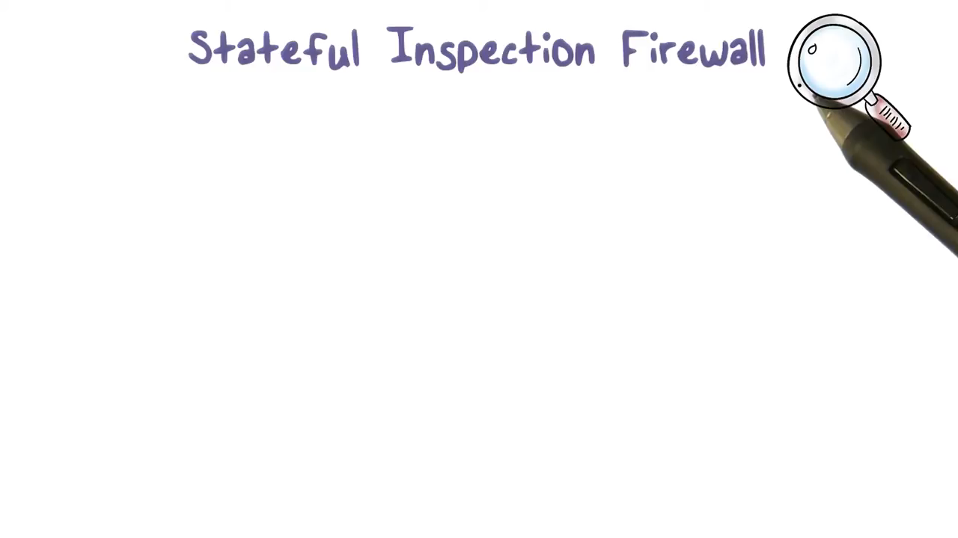
Firewalls Based on Method of Operation
3. Stateful inspection firewalls (DEMO):

Slide 44
Firewalls Based on Method of Operation
4. Proxy firewalls
Also known as web application or application layer firewalls, proxy firewalls route data packets through separate proxy servers. Proxy servers act as a network gateway between remote devices and web applications.
Proxy firewalls screen incoming and outgoing traffic, blocking direct access to web servers without proper authentication.
Proxy firewalls operate at the application layer. They filter by destination port, but also assess data packets using application data. For instance, the firewall may check HTTP request strings to determine whether connections are legitimate.
Operating at the application layer allows security teams to apply controls over web usage. Admins can block access to content according to HTTP addresses. Granular controls also allow access to certain web resources while blocking insecure websites

Slide 45
Firewalls Based on Method of Operation
4. Proxy firewalls
Advantages of proxy firewalls:
Proxy firewalls provide robust security by applying application-level filtering. Security teams can leverage port information, TCP headers and also packet contents.
Application layer firewalls can act as web filters. Security teams can place risky web resources off limits to users.
Disadvantages of proxy firewalls:
Proxies tend to have high data overheads. This may result in impaired network performance.
Security teams may face higher workloads to maintain appropriate filters.
Compatibility issues may arise with web apps and protocols. Application layer or proxy firewalls are well-suited to protecting services that are vulnerable to web threats. For example, they provide extra protection against phishing attacks via malicious links.

Slide 46
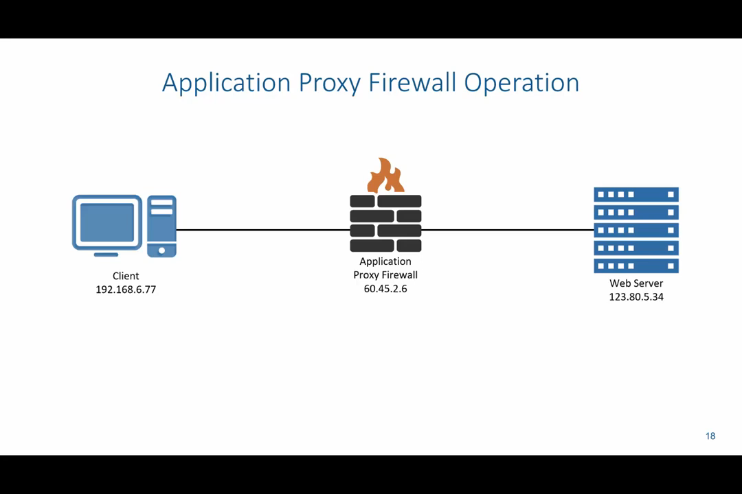
Firewalls Based on Method of Operation
4. Proxy firewalls (Demo):

Slide 47
Firewalls Based on Method of Operation
5. Next-generation firewalls
Next-generation firewalls (NGFWs) build on other firewall types and add extra functionality. Generally, an NGFW will blend packet inspection with the contextual controls offered by Stateful firewalls.
NGFW services offer deep security controls to protect sensitive data. Deep Packet Inspection (DPI) analyzes the content of data packets, not just header information. This extra knowledge allows the firewall to verify the authenticity of HTTP transfers. The result is improved web security.
Anti-malware and antivirus scanning extend protection further. NGFWs also commonly include intrusion prevention and detection systems (IDS/IPS). Intrusion prevention services detect possible threats and deliver alerts before attacks become critical.

Slide 48
Firewalls Based on Method of Operation
5. Next-generation firewalls
Advantages of next generation firewalls:
In-depth threat protection against malware and viruses. Traffic passes multiple filters before reaching network devices.
Delivery of deep security insights to inform threat mitigation strategies.
Contextual analysis adapts to emerging threats. Next generation firewalls often detect threats that other firewalls cannot.
Disadvantages of next generation firewalls:
NGFW systems have higher setup and maintenance costs than alternative firewall varieties.
Users may need to integrate NGFW systems with SIEM technology and access controls to maximize their effectiveness.

Slide 49
Firewall Architectures
Screening Router
Dual Homed Gateway
Screened Host Router
Screened Subnet Architecture

Slide 50
1. Screening Router
The intrinsic and simplest form of firewall implementation involves using the screening router. The screening router represents the technique of running the packet filtering technology on the router.
This single router aims to protect the entire network. It screens all the incoming or outgoing data packets across the network by analyzing the packet headers.
To implement this firewall architecture, one will need a router device and can simply configure the router with packet filtering rules.
The screening router architecture is transparent to the networks involved in the system. Screening routers are easy to implement that results in a low-cost architecture when compared with others. During implementation, there are no changes that have to be made to the client application.
Due to transparency of the architecture, there is always a reasonable potential risk of breaking into the system. The screening router is limited to a single point of failure, which could collapse the whole system. The screening router also lacks the most significant logging feature and user authentication mechanism. It does not offer the defense-in-depth feature and cannot handle certain network traffic. It is also not possible to add complex firewall rulesets to the screening routers. Overall, the screening router cannot typically provide adequate and advanced techniques and features to meet the needs of a complex system.

Slide 51
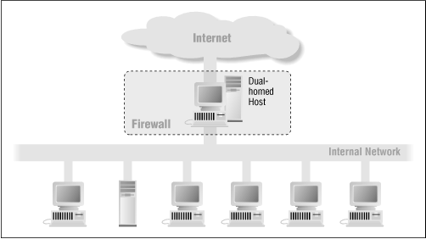
2. Dual Homed Gateway
A dual-homed host architecture is built around the dual-homed host computer, a computer which has at least two network interfaces.
Such a host could act as a router between the networks these interfaces are attached to; it is capable of routing IP packets from one network to another. However, to implement a dual-homed host type of firewalls architecture, you disable this routing function.
Thus, IP packets from one network (e.g., the Internet) are not directly routed to the other network (e.g., the internal, protected network).
Systems inside the firewall can communicate with the dual-homed host, and systems outside the firewall (on the Internet) can communicate with the dual-homed host, but these systems can't communicate directly with each other. IP traffic between them is completely blocked.

Slide 52
2. Dual Homed Gateway (cont.)
Dual-homed hosts can provide a very high level of control. If you aren't allowing packets to go between external and internal networks at all, you can be sure that any packet on the internal network that has an external source is evidence of some kind of security problem.
In some cases, a dual-homed host will allow you to reject connections that claim to be for a particular service but that don't actually contain the right kind of data. (A packet filtering system, on the other hand, has difficulty with this level of control.) However, it takes considerable work to consistently take advantage of the potential advantages of dual-homed hosts.

Slide 53
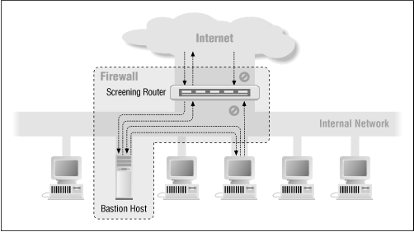
3. Screened Host Router
Whereas a dual-homed host architecture provides services from a host that's attached to multiple networks (but has routing turned off), a screened host architecture provides services from a host that's attached to only the internal network, using a separate router.
In this architecture, the primary security is provided by packet filtering.

Slide 54
3. Screened Host Router
The bastion host sits on the internal network. The packet filtering on the screening router is set up in such a way that the bastion host is the only system on the internal network that hosts on the Internet can open connections to (for example, to deliver incoming email).
Even then, only certain types of connections are allowed. Any external system trying to access internal systems or services will have to connect to this host. The bastion host thus needs to maintain a high level of host security. The packet filtering also permits the bastion host to open allowable connections to the outside world

Slide 55
3. Screened Host Router
Compared to other architectures, however, such as the screened subnet architecture discussed in the following section, there are some disadvantages to the screened host architecture.
The major one is that if an attacker manages to break in to the bastion host, there is nothing left in the way of network security between the bastion host and the rest of the internal hosts. The router also presents a single point of failure; if the router is compromised, the entire network is available to an attacker.

Slide 56
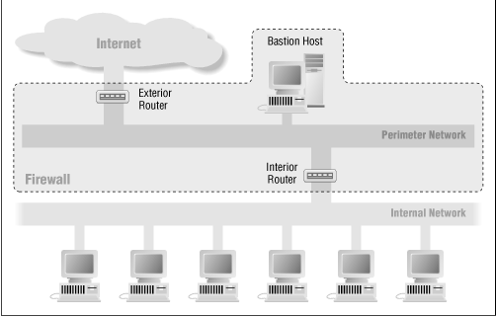
4. Screened Subnet Architecture
The screened subnet architecture adds an extra layer of security to the screened host architecture by adding a perimeter network that further isolates the internal network from the Internet. Why do this?
By their nature, bastion hosts are the most vulnerable machines on your network. Despite your best efforts to protect them, they are the machines most likely to be attacked, because they're the machines that can be attacked.
If, as in a screened host architecture, your internal network is wide open to attack from your bastion host, then your bastion host is a very tempting target. There are no other defenses between it and your other internal machines (besides whatever host security they may have, which is usually very little). If someone successfully breaks into the bastion host in a screened host architecture, he's hit the jackpot.

Slide 57
4. Screened Subnet Architecture
By isolating the bastion host on a perimeter network, you can reduce the impact of a break-in on the bastion host. It is no longer an instantaneous jackpot;
It gives an intruder some access, but not all. With the simplest type of screened subnet architecture, there are two screening routers, each connected to the perimeter net. One sits between the perimeter net and the internal network, and the other sits between the perimeter net and the external network (usually the Internet).
To break into the internal network with this type of architecture, an attacker would have to get past both routers. Even if the attacker somehow broke in to the bastion host, he'd still have to get past the interior router. There is no single vulnerable point that will compromise the internal network.

Slide 58
4. Screened Subnet Architecture
Some sites go so far as to create a layered series of perimeter nets between the outside world and their interior network. Less trusted and more vulnerable services are placed on the outer perimeter nets, fathest from the interior network.
The idea is that an attacker who breaks into a machine on an outer perimeter net will have a harder time successfully attacking internal machines because of the additional layers of security between the outer perimeter and the internal network.
This is only true if there is actually some meaning to the different layers, however; if the filtering systems between each layer allow the same things between all layers, the additional layers don't provide any additional security.

Slide 59
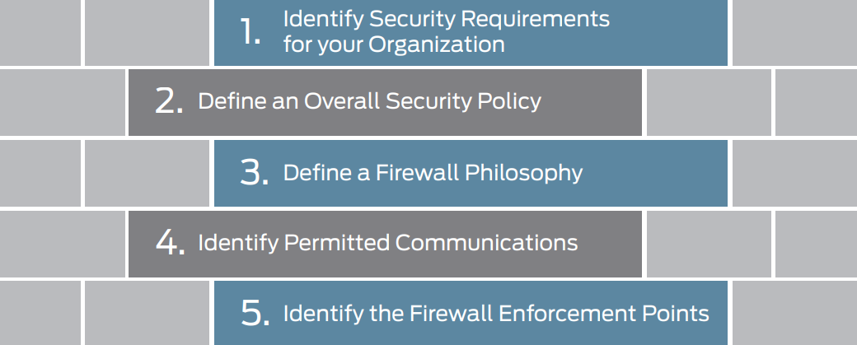
Process of Firewall Design

Slide 60
Firewall Planning and Design Processes
As many people know, firewall design entails far more than just configuration of the firewall. Processes that comprise an organization’s overall security policy inform decisions such as which firewall features are used, where the firewall is enforced, and ultimately, how the firewall is configured.
Firewall technology has evolved from packet filter firewalls to today’s next-generation firewalls, and at each stage, new services and solutions have emerged to address the expanding complexity of the cyber landscape—to protect resources and to stop cyber attackers from breaching the firewall for nefarious purposes.
Today’s sophisticated firewalls incorporate a range of features and services that are the outgrowth of these stages of firewall evolution. There are five firewall design tasks that apply whether you plan to deploy a single firewall with limited features or multiple full-featured firewalls for the various areas of your environment.

Slide 61
Step 1. Identify Security Requirements for Your Organization
Before you can secure your network environment, you need to understand your organization’s resources and security requirements, and your current security posture.
Here are suggestions on how to carry out that assessment:
Conduct an investigation to identify what it is that you need to protect.
Catalog your environment’s assets and resources. For example:
Identify resources deployed throughout your campus, including the hardware and software that make up your environment and network.
Characterize your resources. For example, identify publicly available databases and customer-facing systems, resources that have high concentrations of sensitive data, and legacy security devices.
Identify your data. Specify how to handle and protect it. Assign quantifiable value to your resources. Consider data sensitivity and who uses the data.
Identify transaction flows. Data is most exposed to risk when it moves.

Slide 62
Step 1. Identify Security Requirements for Your Organization
Note vulnerabilities and potential threats to each resource. Identify systems used by IT-breaches to IT security that could disable the entire network.
Scan your Internet address ranges.
Identify your partners and guest access network connections.
Change hats: View your environment as a cyber attacker would.
Ensure that your operating systems and applications are updated with the latest patches.
Have a third-party group conduct a vulnerability assessment. The group can identify critical vulnerabilities in your network.

Slide 63
Step 2. Define an Overall Security Policy
Regardless of its size, before an enterprise can secure its assets, it requires an effective security policy that does the following:
Identifies all network resources and their required security
Includes a network infrastructure map that is revised as systems are added to or removed from the topology
Encompasses the organization’s firewall philosophy
Covers permitted communications and access policies and defines access rights and access levels based on employee job functions and roles
Defines the culture of the organization with respect to security and how its policies are applied
Defines security threats, how to thwart them, and how to respond to successful attacks.

Slide 64
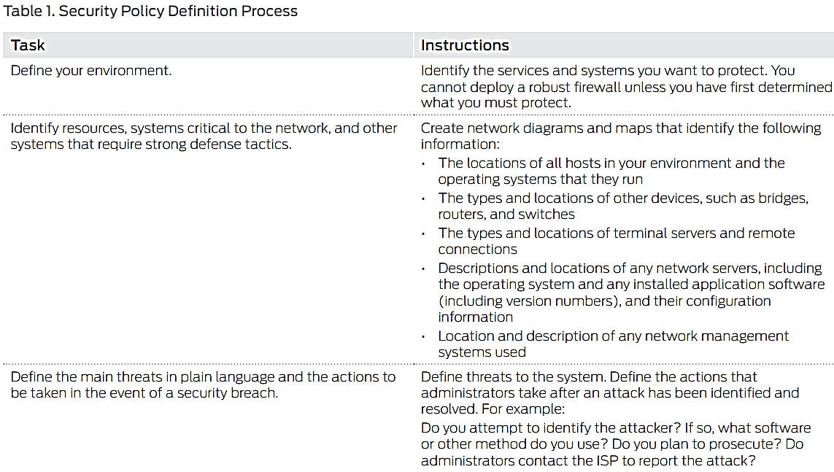
Step 2. Define an Overall Security Policy

Slide 65
Step 3. Define a Firewall Philosophy
A firewall philosophy is the part of your site’s security policy that applies strictly to the firewall and defines your overall goals for the firewall. It provides written guidelines that any administrator can follow in implementing the firewall deployment. If you identify how resources, applications, and services are to be protected, it is much easier to define and configure the firewall itself.
A firewall philosophy is also essential when new hosts and software are added to the network. It can serve as a means of communicating the current firewall deployment, and factors that contribute to its deployment, to successive IT personnel.
Even simple firewalls need a well-documented firewall philosophy to guide their design, deployment, and maintenance. Without one, the firewall itself might become a security problem. Table 2 suggests some components you can include in your own firewall philosophy review document.

Slide 66
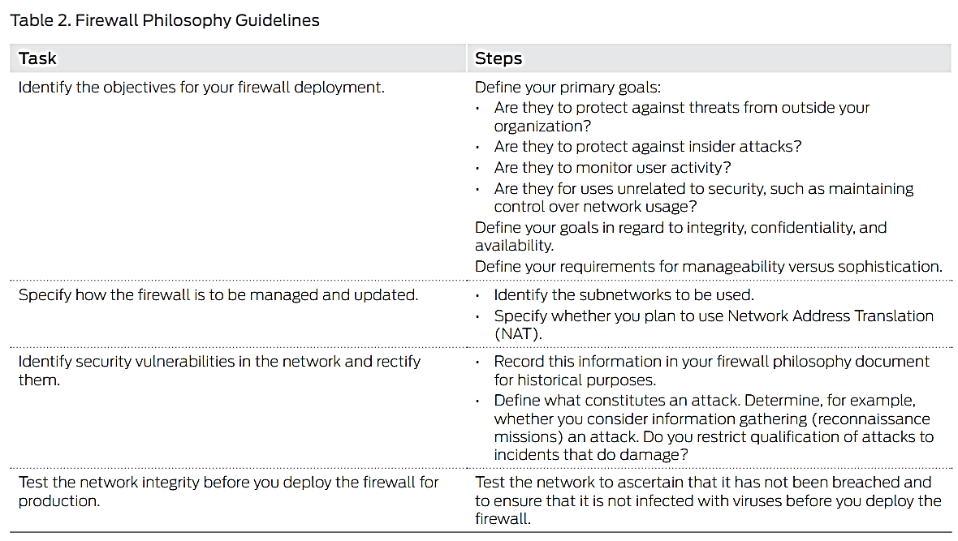
Step 3. Define a Firewall Philosophy

Slide 67
Step 3. Define a Firewall Philosophy
You can establish an overall approach or security stance of least privilege or greatest privilege to guide the development of your firewall philosophy, depending on your network requirements:
• Least privilege—Lock down the network. Block all network connections in both directions, within the LAN and in relation to the Internet. After all interzone and intrazone traffic is blocked, you can unblock it selectively through policy configuration. The policy configuration can then define precisely and incrementally what is allowed. Least privilege is the more common approach to deployment of a firewall.
• Greatest privilege—Trust everything inside the network. The policy can then designate specific denial of access to close down access as appropriate. This stance is sometimes taken when the firewall is deployed inline while network activity continues. In this case, the stance allows the firewall to be deployed without disturbing normal business activity that is conducted using the network.

Slide 68
Step 4. Identify Permitted Communications
Define an acceptable use policy to specify the types of network activities that are allowed for use on the LAN and allowed for Internet services and applications.
To design effective firewall policies, you must understand which applications are currently used. Network administrators are not always aware of all of them, especially in regard to use of the Internet. Employees might not be aware that social media and instant messaging applications open entry points into the network that provide easy access for attackers. Maintaining a list of allowed applications and services, any known security risks associated with them, and the means used to secure the application or service is a best practice.
Understand and document the workflow in your organization based on employee roles and applications allowed for each role.
Gathering this information can help you define your firewall. Most of the work is already done, and then the firewall configuration simply becomes a software configuration task.

Slide 69
Step 4. Identify Permitted Communications
When you define allowed communications and access permissions, take into account the type of firewall that you plan to deploy to enforce these requirements. Although packet-filtering firewalls that operate up to Layer 3 (transport) and stateful firewalls that operate up to Layer 4 (network) continue to serve specific purposes, they do not provide adequate network protection required to defend against Web-based attacks.
Web-based attacks can easily pass through well-known ports—HTTP (port 80), HTTPS (port 443), and e-mail (port 25). Packet-filtering and stateful firewalls that are based on protocols and ports are unable to distinguish legitimate applications that rely on those protocols and ports from illegitimate applications and attacks. They are unable to distinguish one kind of Web traffic that uses the port from another.
The emergence of application firewalls has given IT teams granular control over access to applications. Application firewalls examined the application and protocol with which a packet was associated and the ports it used. They could monitor and block application traffic and system service calls, controlling access to services and applications previously made widely available. After you have defined the allowed services and applications and your user access workflow, it is vital to communicate that information to employees in a way that is visible and available.

Slide 70
Step 5. Identify the Firewall Enforcement Points
Every network has unique characteristics that require equally unique firewall deployment solutions. Many companies deploy different types of firewalls throughout their environment based on the assets and access points they want to protect. Regardless of where the firewall is enforced, simple firewall designs are more likely to be secure and are easier to manage than complex ones. While special requirements might warrant firewall complexity, unwarranted design complexity lends itself to configuration errors.
Determining enforcement points is fundamental to firewall design. As a rule, the primary use of the firewall should dictate its enforcement points and configuration. Firewalls are commonly deployed at the edge, or border, between the private LAN and a public network, such as the Internet. However, there are other firewall enforcement points to consider, such as the DMZ, also known as a perimeter or bastion network. Firewalls are designed and enforced differently in these areas of a network because each area has its specific security requirements,

Slide 71
Network Areas and Firewall enforcement
Edge: Internet-Facing Firewall
Protects the border of the network against unauthorized access from the Internet
Defends its hosts against all forms of attack from outside the LAN
Ensures that authorized users are able to perform required tasks by thwarting denial of service (DoS) and other forms of lockout attacks launched from outside the LAN
Guards the entry points to the LAN by checking each packet to determine if it is allowed through
Core: Corporate-Facing Firewall
Protects corporate resources from internal opportunistic, accidental, or malicious attacks, such as data theft or DoS floods instigated through a virus.
Provides outgoing traffic-handling policies
Ensures that employees have access only to the Internet services they require
Protects against employee use of the network to launch outside attacks
Firewall in the DMZ
Provides additional security by creating a less secure area in front of the private network to provide a first line of defense behind which the internal LAN hosts can safely exist
Contains, as a rule, publicly accessible servers and bastion hosts—if servers are attacked, hosts within the LAN are not compromised

Slide 72
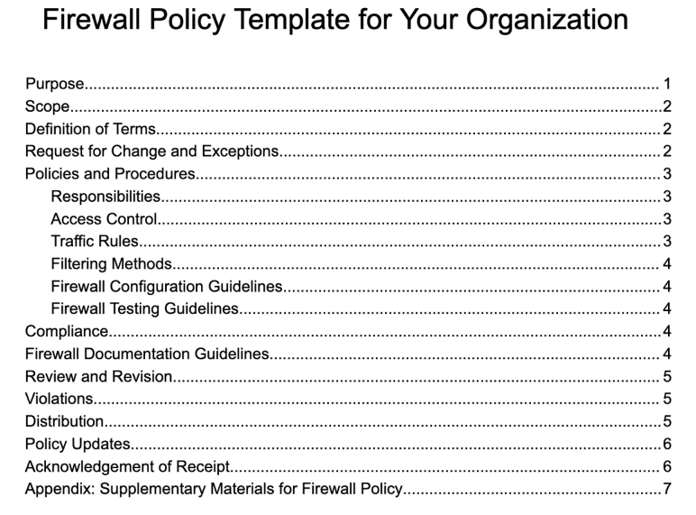
Firewall Policy Formalization with Rules

Slide 73
Components of Firewall Policies
Key firewall policy components include user authentication mechanisms, access rules, logging and monitoring methods, rule base, and numerous rule objects that specify network communication conditions. They are listed as follows:
User Authentication
Access Rules
Logging & Monitoring
Rule Base
Rule Objects
User & Application-Based Rule Objects
Network-Based Rule Objects
Time-Based Rule Objects
Service & Service Group Rule Objects

Slide 74
Components of Firewall Policies
Rule Objects
Rule objects define access rules and in-corporate components such as applications, source or destination hosts, and networks. Examples include Users, User Groups, Applications, Application Groups, Countries, IPv4/IPv6 Endpoints, Host DNS Names, and more. Rule objects improve policy administration by providing a structured mechanism to group items used in access rules.
User & Application-Based Rule Objects
User and User Group rule objects are based on Windows Active Directory users and user groups. Application rule objects employ the signature set to identify diverse software packages. Application Groups combine various apps for unified handling. These rule objects provide detailed control over user and application-specific traffic, boosting security and resource management.

Slide 75
Components of Firewall Policies
Network-Based Rule Objects
IPv4/IPv6 Endpoints, Host DNS Names, IPv4/IPv6 Address Ranges, and Networks define source/destination criteria. Country rule objects allow/block traffic based on the countries of origin and destination. For easier management, Network Group rule objects integrate several network-related rule objects. These rule objects set communication criteria, enabling or blocking traffic based on network properties.
Time-Based Rule Objects
Finite Time Period implements time interval-specific constraints. Repeated rule enforcement can be executed with Recurring Time Period and Recurring Time Period Group. Time-based rules control network access by aligning with certain timeframes and intervals.

Slide 76
Components of Firewall Policies
Service & Service Group Rule Objects
Service rule objects limit traffic depending on IP protocols, ICMP codes, or TCP/UDP port numbers. Service Group rule objects combine services for consistent policy management. These rule objects establish communication parameters, ensuring control over certain services and protocols.

Slide 77
3 Main Types of Firewall Policies
There are three fundamental types to creating firewall policies: hierarchical, global network, and regional network, each with its own set of advantages based on organizational needs.
Understanding these types enables enterprises to create firewall policies that not only achieve security objectives but also integrate smoothly with their particular business landscapes.

Slide 78
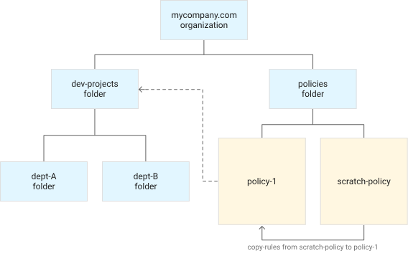
Hierarchical Firewall Policy
The hierarchical firewall policy takes an organized approach to rule organization by grouping rules in a hierarchical style and assigning unique rules to each security zone.
This gives businesses granular control over network traffic, allowing them to fine-tune security measures based on varied requirements inside distinct zones. While this strategy provides thorough control, it needs rigorous maintenance for effective and comprehensive security posture

Slide 79
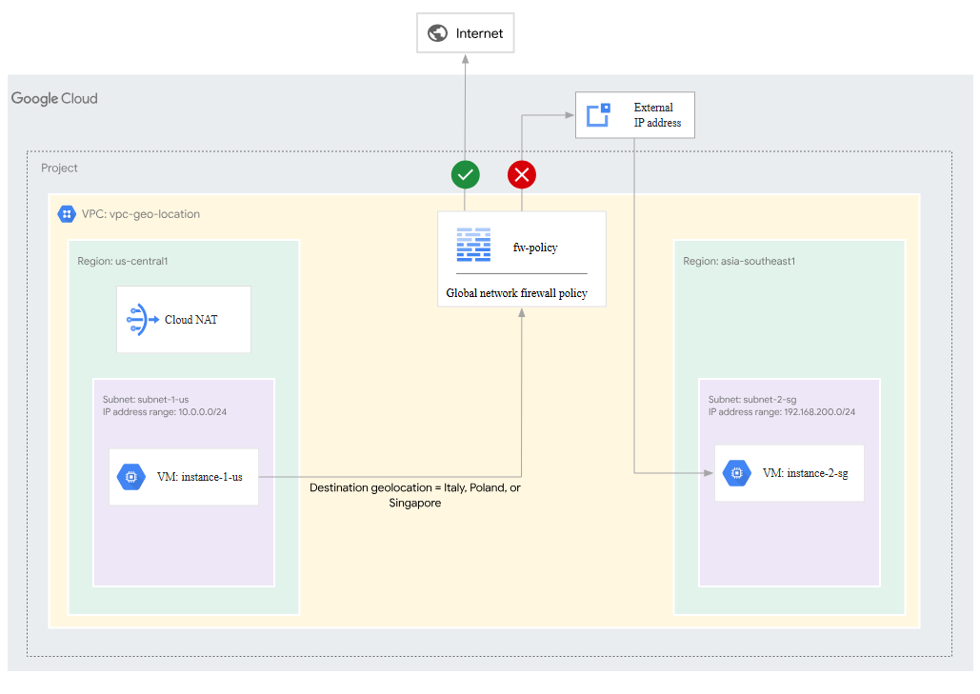
Global Network Firewall Policy
A global network firewall policy, in contrast to the hierarchical model, opts for standard rules that are implemented consistently across all security zones in an organization.
This offers a streamlined and uniform security environment. However, because the standards are global in design, they may lack the specificity required for businesses with varying security demands across many zones, potentially resulting in a one-size-fits-all approach.

Slide 80
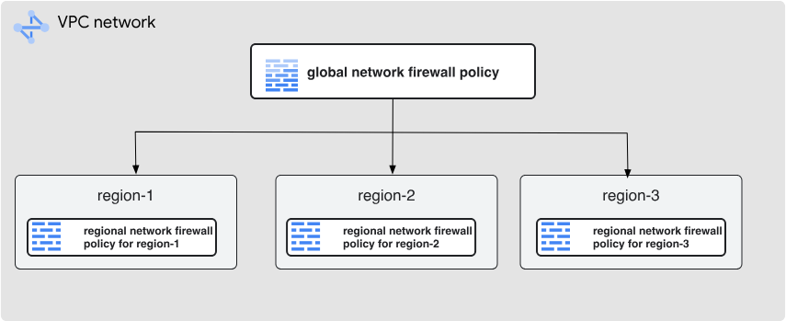
Regional Network Firewall Policy
The regional network firewall policy, designed for enterprises with regionally distributed operations, achieves a balance between meeting the security needs of many sites while keeping a centralized approach to policy administration.
This enables businesses to successfully address difficulties and ensures that security measures are optimized for the specific threats and landscapes encountered in various geographic areas.

Slide 81
9 Steps to Create a Firewall Policy
Deploying firewalls is a standard precaution that becomes more effective when combined with a well-defined firewall policy.
Strategic steps of a strong firewall policy include stating the purpose, scope, definitions, exceptions and change guidelines, detailed policies and processes, compliance guidelines, documentation, violations and sanctions, and distribution process.

Slide 82
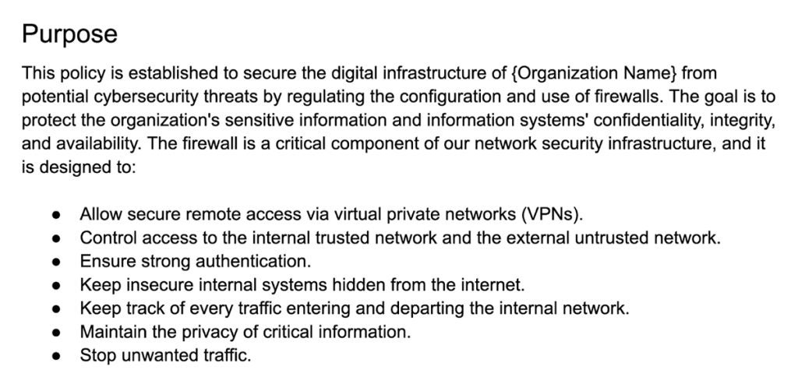
1. State the Purpose
List the firewall’s intended goal, such as securing sensitive data, restricting network access, or protecting against specific threats. This clarity ensures that the firewall matches with broader security goals and serves its intended purpose. If the primary purpose is to protect sensitive customer information, for example, the policy should highlight methods to secure data exchanges and prevent unwanted access.

Slide 83
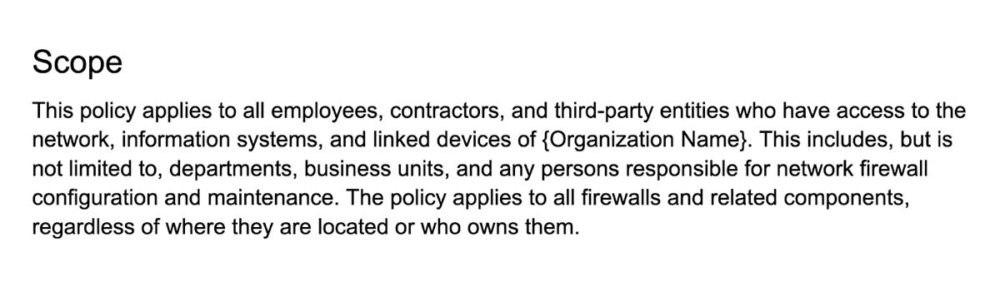
2. Identify the Scope
Specify the networks, systems, and data that are covered by the policy to prevent ambiguity and ensure that it covers the intended assets.
Organizations can adapt their firewall rules to protect specific assets by explicitly defining the scope, making the policy more targeted and effective. If the scope encompasses both internal and cloud-based systems, the policy may need to account for distinct security issues for each environment.

Slide 84
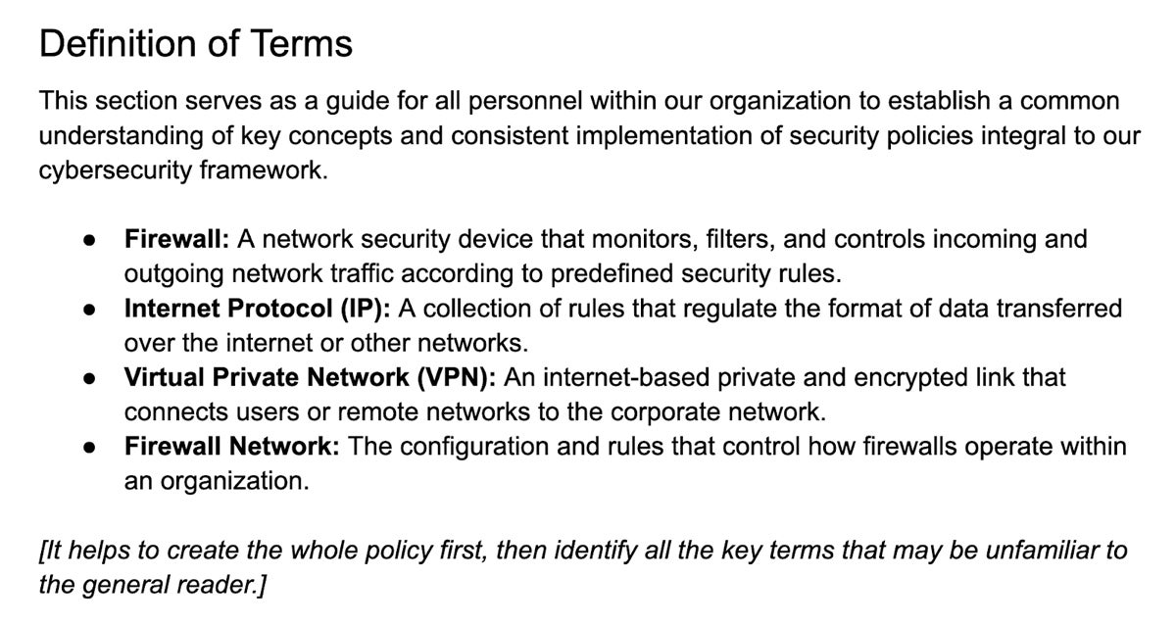
3. Define Key Terms
Establish explicit definitions for terms to create a shared understanding among all stakeholders involved in policy implementation. Determining the key terms ensures that everyone interprets and manages the material consistently, lowering the chance of miscommunication and errors. Consider creating the whole policy first to identify all the key terms that may be unfamiliar to the general reader.

Slide 85
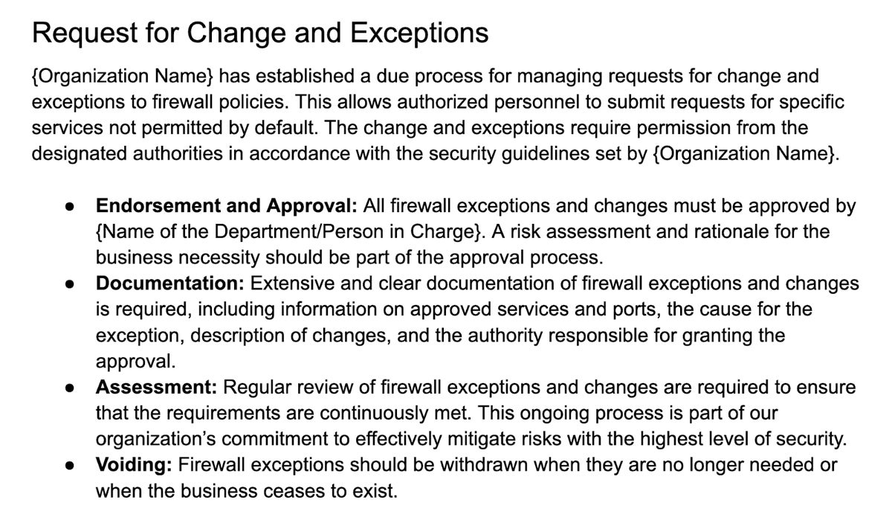
4. Establish Exceptions & Change Processes
Create a transparent procedure for requesting and approving changes and exceptions, including the relevant paperwork, to balance flexibility with strong security rules. This guarantees that exceptions are given based on valid business reasons and are documented and reviewed on a consistent basis. If a department needs specific ports open for a project, the exception process will define the stages for approval as well as the documentation needed.

Slide 86
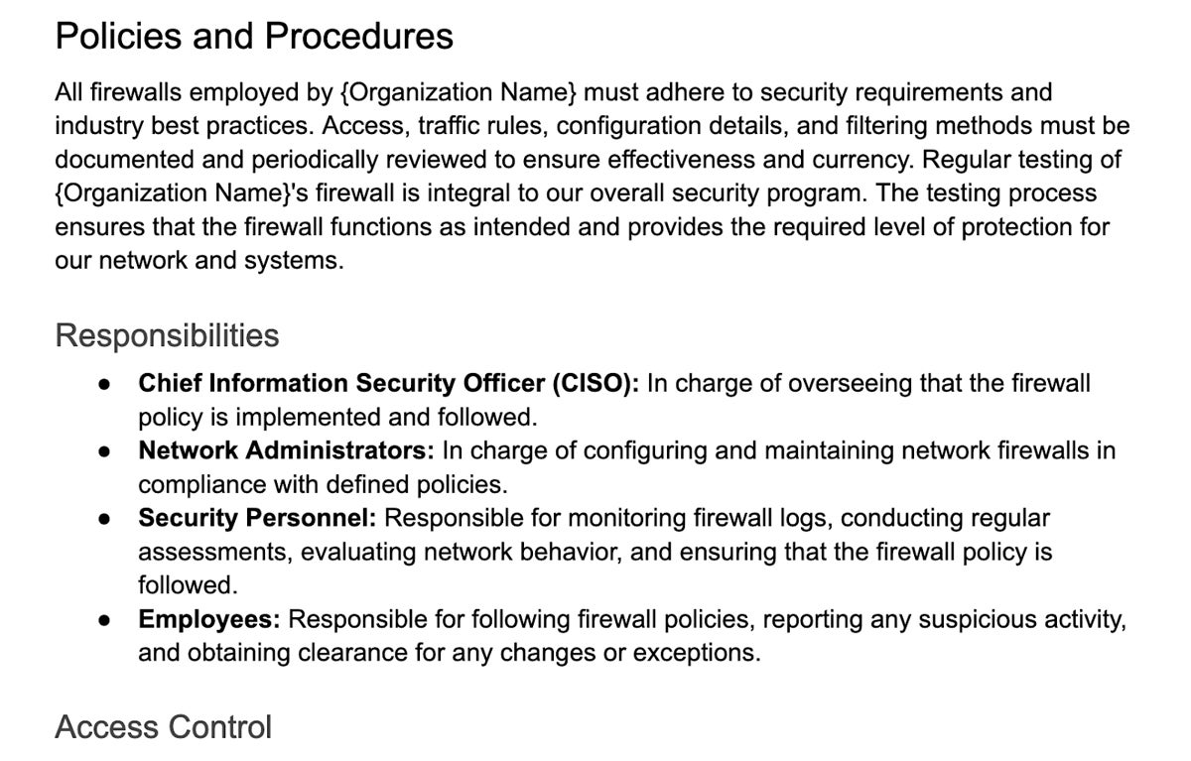
5. Detail Policies & Procedures
Outline specific duties, rules for inbound and outbound traffic, policy infractions, and rule update procedures to ensure full policy execution. This phase provides detailed guidance to assist organizations in constantly enforcing security measures. As an example, detailing methods for modifying firewall rules, ensures that changes are carried out in a uniform manner, reducing the chance of misconfigurations.

Slide 87
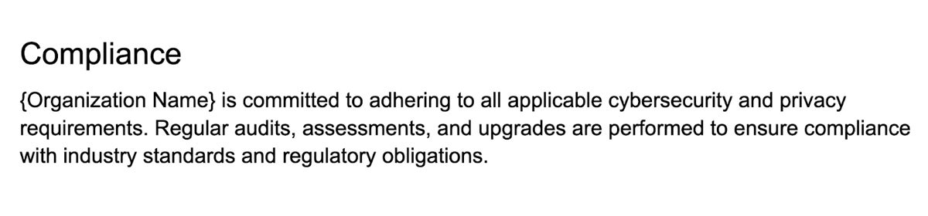
6. Address Compliance Requirements
Ensure that the firewall policy complies with relevant cybersecurity and privacy requirements. This displays the organization’s dedication to legal and regulatory norms, lowering the danger of legal ramifications. For example, if the firm handles healthcare data, the firewall policy must comply with the Health Insurance Portability and Accountability Act (HIPAA) to protect patient information and ensure compliance.

Slide 88
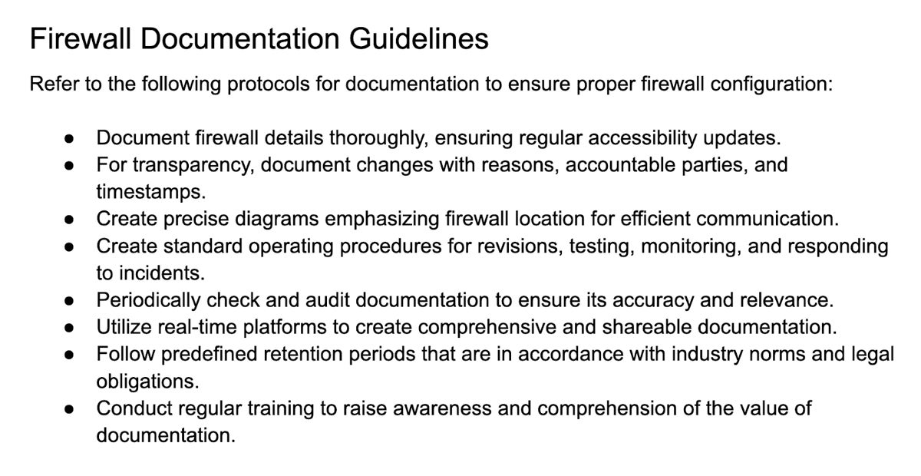
7. Maintain Thorough Documentation
Keep detailed records of firewall setups, changes, exceptions, and testing results. This documentation is useful for audits, troubleshooting, and future policy updates. Create a documentation guideline to allow enterprises to monitor and easily review the updates done for firewall setups. This supports easier troubleshooting and provides insights for continual improvement.

Slide 89
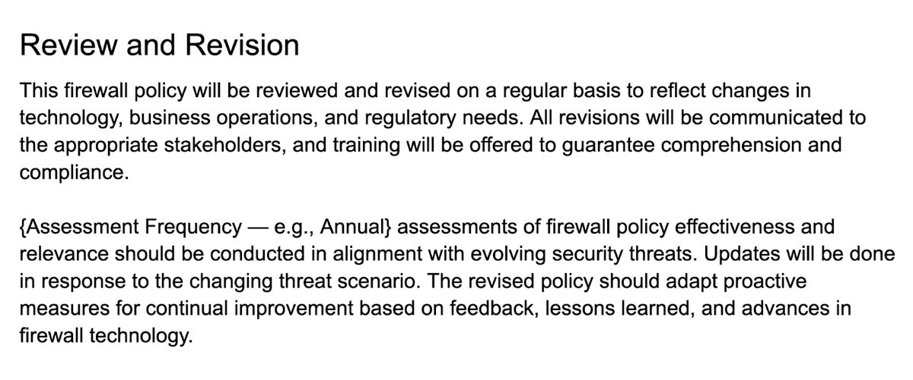
Also set the frequency of review and revision in terms of time intervals (monthly, quarterly, or annual). Specify the circumstances in which the policy must be reviewed and revised, such as adapting to an advancement in firewall technology. Also specify the strategies for continuous development based on feedback and insights.

Slide 90
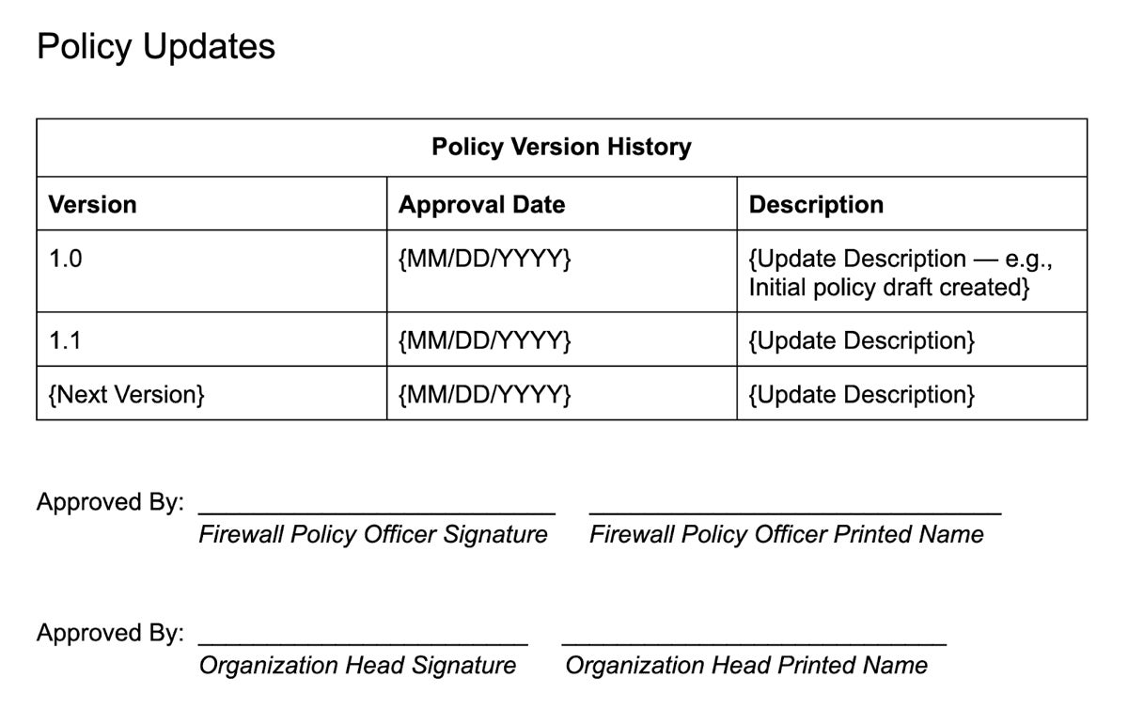
Finally, fill out the policy version history to note any and all updates to the policy, as well as the approvers of the newest version.

Slide 91
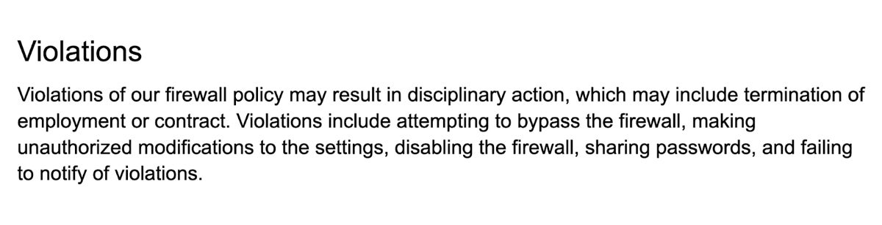
8. Define Violations & Penalties
Clearly define the consequences of policy infractions, such as purposeful firewall bypassing or other prohibited conduct, to encourage a culture of accountability. For example, state that attempting to disable the firewall without authorization leads to warnings, disciplinary proceedings, or termination of employment. Encourage staff to adhere to security regulations and prevent illegal activity.

Slide 92
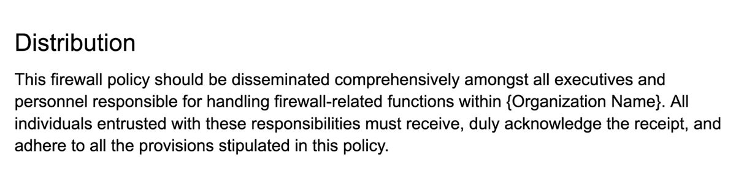
9. Plan the Policy Distribution
The Distribution section guarantees that the policy reaches all relevant individuals in charge of firewall-related responsibilities within the organization. This dissemination ensures that everyone involved is aware of the policy, confirms receipt of it, and agrees to comply with its terms.

Slide 93
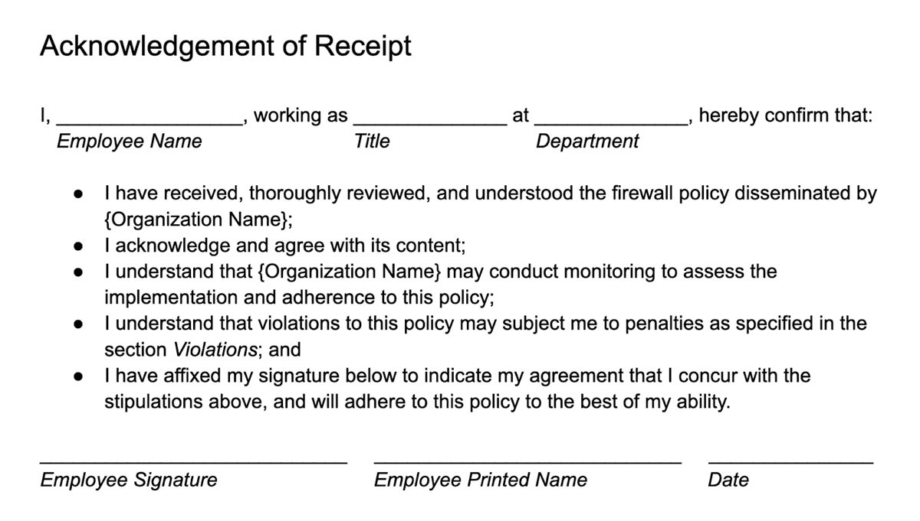
Each employee should acknowledge receipt and compliance with the policy via their signature at the bottom of the document.

Slide 94
Firewall Evaluation and Making them Intelligent

Slide 95
Firewall Evaluation
Firewall evaluation is a tricky multistep process that involves various tasks, the most commonly executed being:
Firewall verification: a test to verify that the built firewall is able to drop or accept the given packets.
Firewall implication: a test that evaluates the firewall effectiveness by comparing its performance on the given set of packets against other firewalls.
Firewall equivalence: a test of similarity between two firewalls to check, whether the firewall under consideration accepts and drops the same packets as the known firewall does.
Firewall adequacy: a test of functionality, whether the firewall drops or accepts at least one packet.
Firewall redundancy: a test that checks if modifying or dropping a given rule changes the firewall output.
Firewall completeness: a test to confirm that the firewall makes a binary decision (block or accept) on each and every packet and no packet is left undecided.
The tests results are typically used to evaluate and compare different firewalls along with its performance on attack detection as well as their speed and resource consumption.

Slide 96
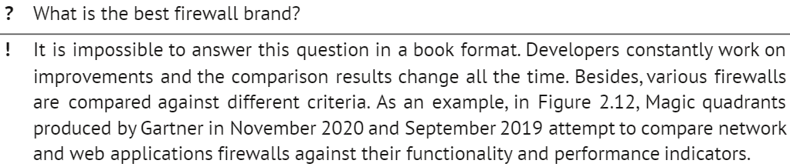

Slide 97
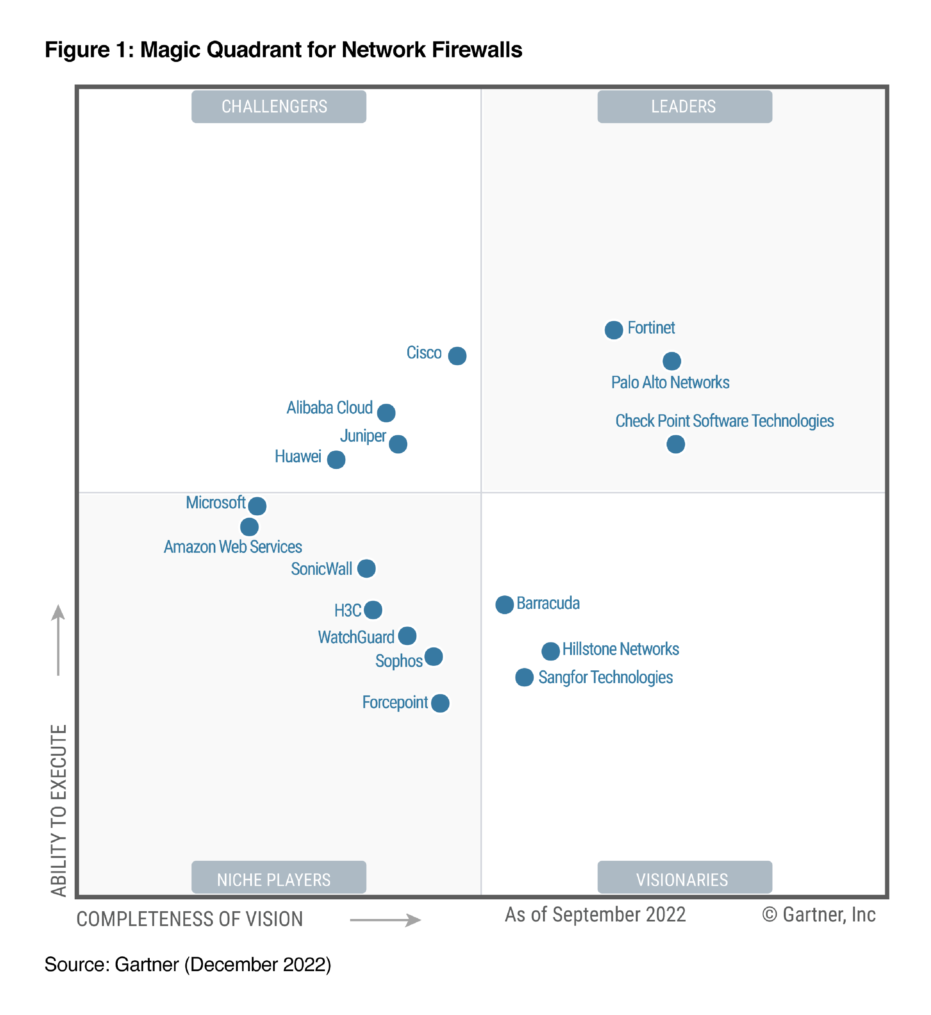

Slide 98
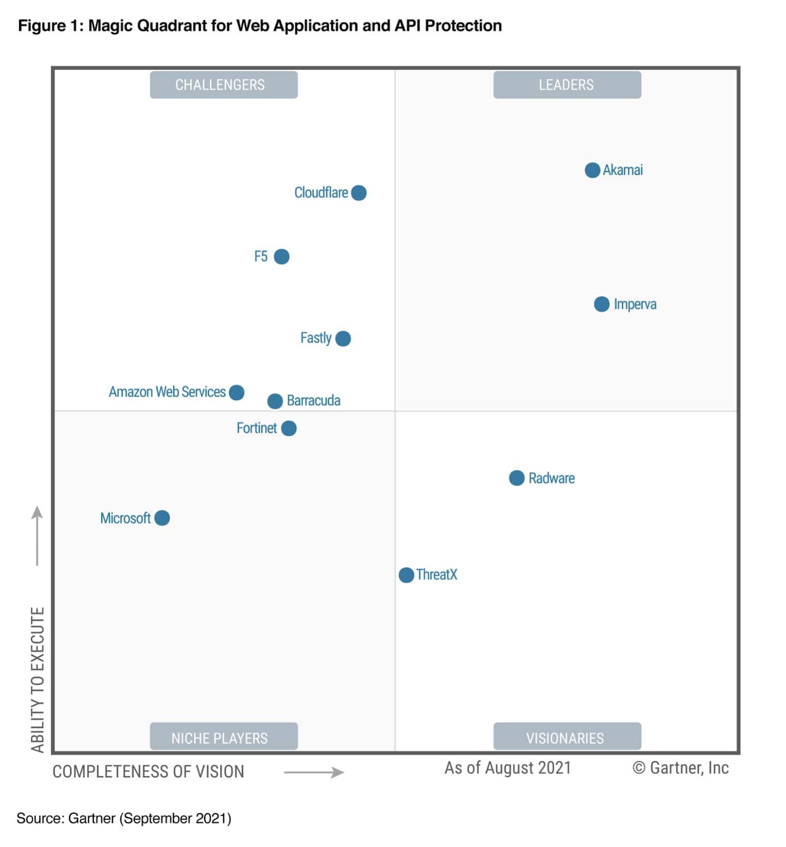

Slide 99
Making Firewalls Robust with Fuzzy Logic

Slide 100
Fuzzy logic employment would allow generalizing the firewall rules. Conventional firewalls explore rules in the binary format: IF source address XXX AND destination address YYY THEN ALLOW. Those rules consider only binary conditions: the packet might or might not come from a particular address, it might or might not go to a particular destination.
The decision to allow or not this packet through will depend only on these two conditions regardless of any other conditions or a firewall type, meaning that all packets should be allowed to go through if they come from a specified source and go to a specific destination.
Fuzzy rules operation is based on a multivalued logic, in which everything is a matter of degree. The rules will look the following way:
Rule 1: IF TRUST in source address XXX is HIGH AND TRUST in destination address YYY is HIGH ALLOW with HIGH confidence.
Rule 2: IF TRUST in source address XXX is LOW AND TRUST in destination address YYY is LOW ALLOW with LOW confidence.
Rule 3: IF TRUST in source address XXX is HIGH AND TRUST in destination address YYY is LOW ALLOW with MEDIUM confidence.
Rule 4: IF TRUST in source address XXX is LOW AND TRUST in destination address YYY is HIGH ALLOW with LOW confidence.

Slide 101
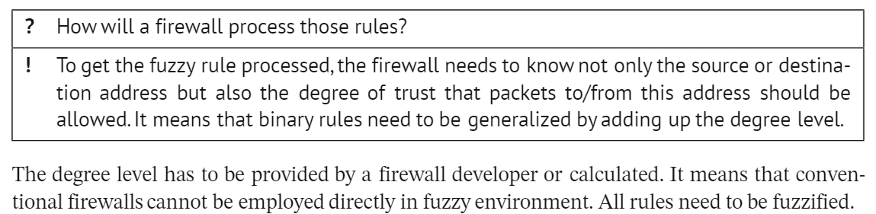
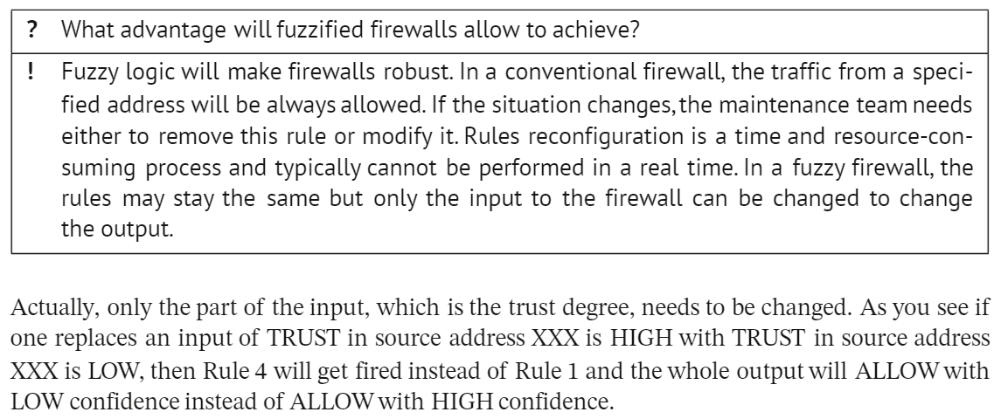

Slide 102
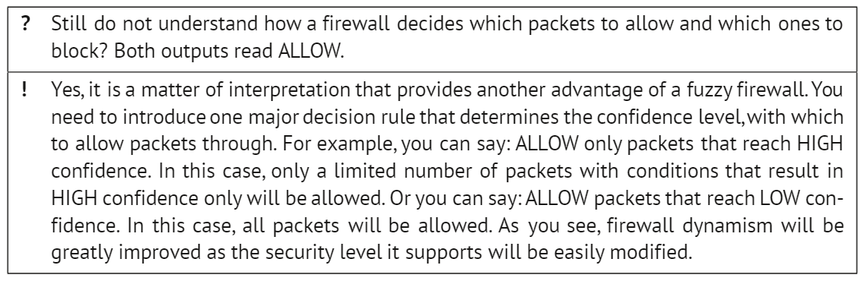

Slide 103
Dynamic Firewall Updating with Machine Learning

Slide 104
Such systems actually combine firewalls with IDS making them work together and creating intrusion prevention systems. The general structure of such a system is shown in the next slide.
For example, Barna et al. (2014) created a dynamic firewall that uses traffic data to make or adjust rules. It can detect normal load statistics and then, when it finds it is under attack, creates a new series of rules to ward off the attack for a temporary period of time (Barna et al. 2014).
The dynamic firewall has a decision engine that sets rules based on incoming traffic using an anomaly detection. The reverse proxy does the job of either allowing traffic through to the application or sending it to be analyzed by the analyzer. The analyzer may also send traffic through to the application depending on whether it believes the traffic is benign or not.

Slide 105
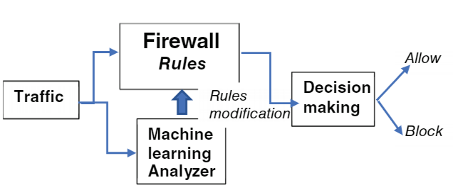
One way, vendors have sought to tackle the issue of complexity is by creating the Unified Threat Management (UTM) firewall, which grows from a simple firewall to become a rather an all-in-one package, generally used by those with less expertise or less manpower. These firewalls commonly include all the basic features of a firewall, but IDS are included along too (Michael Stewart 2014). The combination of a firewall and an IDS is also sometimes called an intrusion prevention system (IPS) (Fulp 2017), which would be far easier to implement than setting up multiple systems.

Slide 106
Next Generation Firewalls

Slide 107
A newer type of firewall, called the next-generation firewall (NGFW), was introduced after the UTM. These firewalls tend to focus on a more specific subset of capabilities and attempt to deliver in performance and customization.
UTM design goal is to simplify its use. It means that only realistic targets in firewall design are considered. The major choice of whether or not to use a certain option is based mainly on a particular organization capability, such as their budget and expertise rather than an attempt to build up the best firewall. These days, when attack deployment speeds are rapidly increasing, organizations do not only require high security, but they would like their firewalls to operate at wire speeds too. Many firewalls, including both UTMs and NGFWs, are too slow and lose the competition against the attacks (Malecki 2012).
Another thing that has not changed is how even NGFWs are mainly focused on external threats, still leaving the system vulnerable to insider's attacks. This is exacerbated by rapidly changing technology such as cloud computing, which opens up new avenues for attacks. The advent of remote work also opens up other ways to attack firewalls.

Slide 108
With the advent of new technologies such as voice over IP (VoIP), a new very specific subtype of firewalls called an SBC, or Session Border Controller (Bridger 2015), was created for use in conjunction with traditional firewalls. This firewall can replace information in session initiation protocol (SIP) packets for additional security and can also prevent against SIP floods. Traditional firewalls have difficulty figuring out whether SIP packets are legitimate or not due to the fact that a single VoIP session can have multiple connections.
There are also other firewalls like PBX firewalls, which help filter phone calls within and outside an organization. They can filter based on phone calls' sources and destinations similar to how a packet filter analysis works based on the traffic packet's content. For example, a rule to include into PBX firewall might be to allow all 911 calls.
Aside from new network technologies, the current development involves the AI rise in all aspects of computing. AI algorithms are utilized to make decisions in firewall's monitoring and analysis. Not only can ML algorithms check if the rules for a firewall are correct by analyzing a firewall's logs, but they can also monitor over all hours for any suspicious activity.
An AI algorithm would be quicker than the average human to react to an attack. Additionally, it could summarize the issues and tell administrators, especially less experienced ones, what to do. Rather than being a replacement for a security professional, AI should be utilized in conjunction with a human being. However, a possible worry is that attackers could exploit the AI to remove and add rules that could compromise the system.

